Slide 2
solve various problems relating to speed, distance, time, and average speed.

Slide 3

Problem 1
Calculate the speed of a bus which covers a distance of 120 Km in 5 hours.
D = 120 Km
T = 5 hours
S = ?
S = $\frac{\text{D}}{\text{T}}$
S = $\frac{\text{120}}{\text{5}}$
S = $\text{2}\text{4 }\text{Km}\text{/}\text{h}$
24

Slide 4
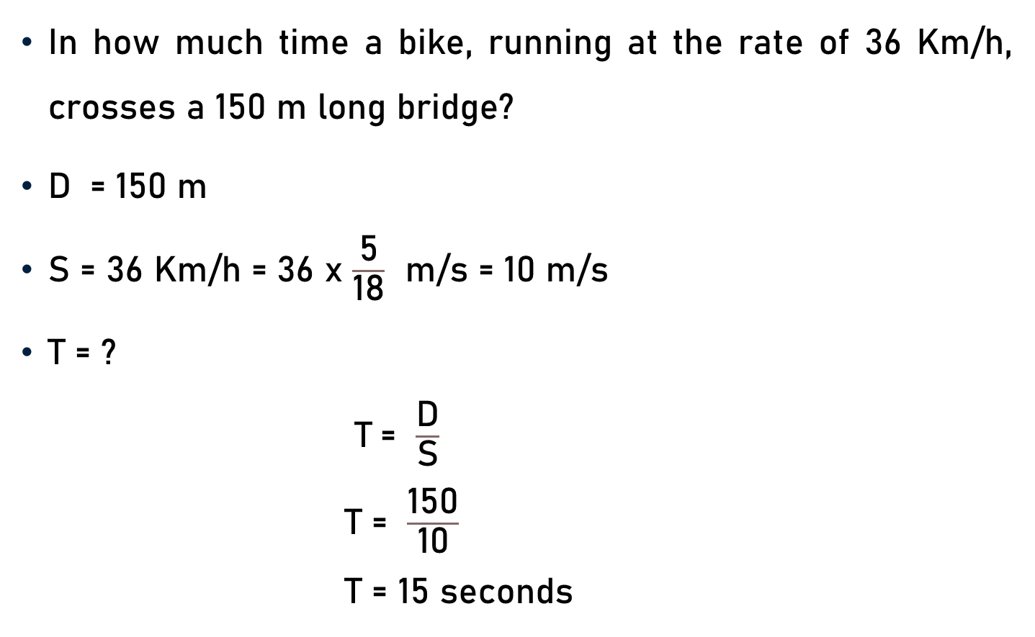
Problem 2
In how much time a bike, running at the rate of 36 Km/h, crosses a 150 m long bridge?
$\text{D}$ = 150 m
S = 36 Km/h = 36 x $\frac{\text{5}}{\text{18}}$ m/s = 10 m/s
T = ?
$\text{T}$= $\frac{\text{D}}{\text{S}}$
T = $\frac{\text{1}\text{5}\text{0}}{\text{10}}$
T = $\text{15 }\text{seconds}$
2
15

Slide 5
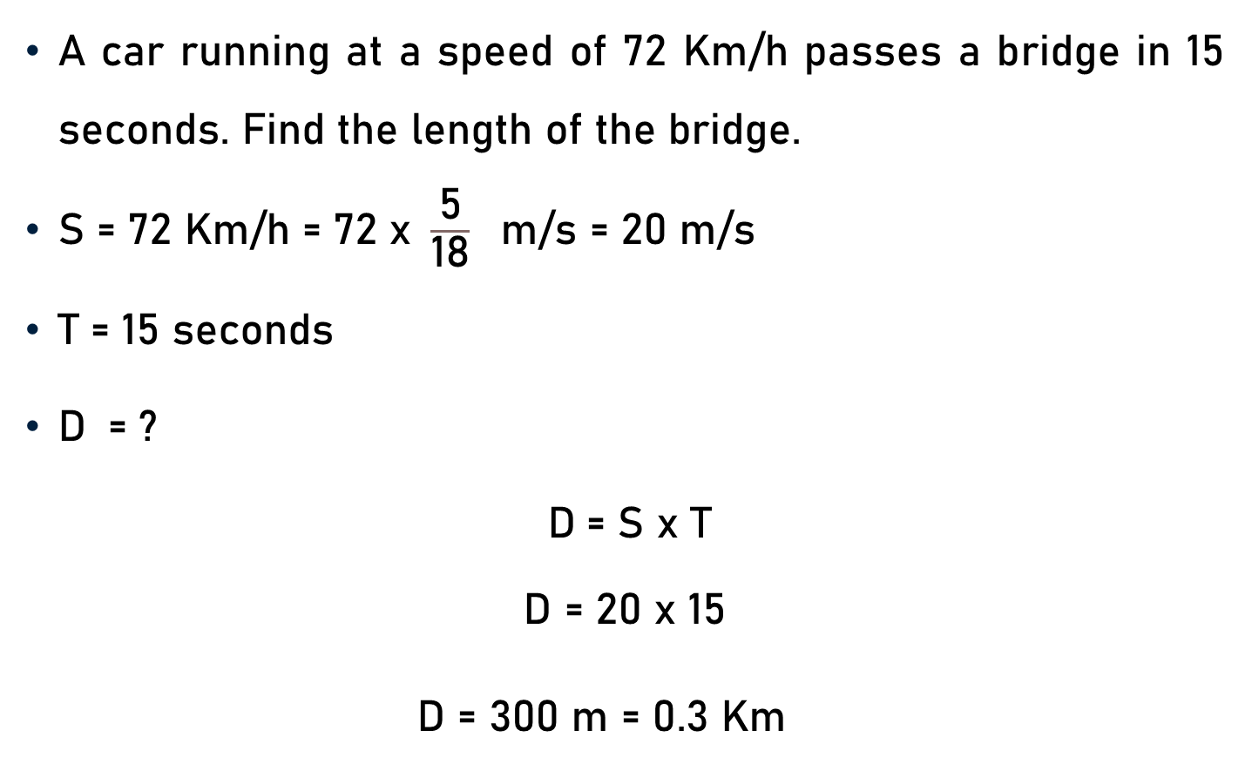
Problem 3
A car running at a speed of 72 Km/h passes a bridge in 15 seconds. Find the length of the bridge.
$\text{S}\text{ = 72 }\text{Km}\text{/}\text{h}\text{ = 72 }\text{x} \frac{\text{5}}{\text{18}} \text{m}\text{/}\text{s}\text{ = 20 }\text{m}\text{/}\text{s}$
$\text{T}\text{ = 15 }\text{seconds}$
$\text{D} \text{ =} \text{?}$
$\text{D} \text{=} \text{S}$ x $\text{T}$
$$\text{D}\text{ =}\text{ 20} \text{x}\text{ 15}$$
$\text{D}\text{ = }\text{300 }\text{m}$ = 0.3 Km
4

Slide 6
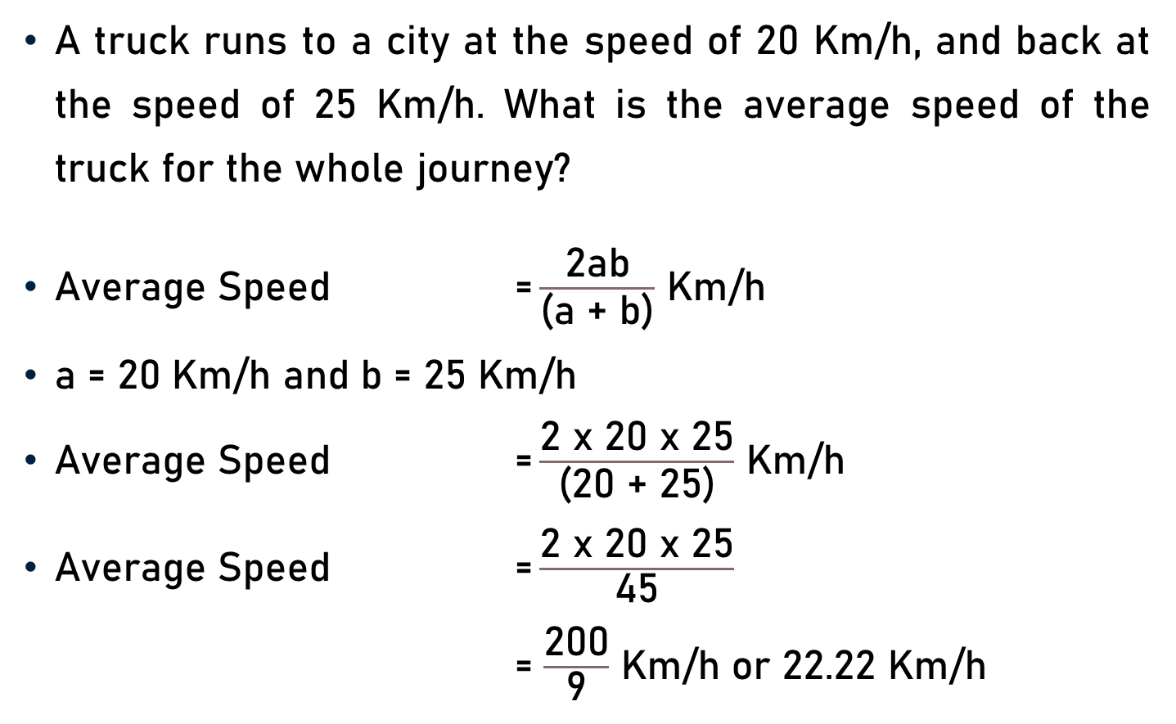
Problem 4
A truck runs to a city at the speed of 20 Km/h, and back at the speed of 25 Km/h. What is the average speed of the truck for the whole journey?
Average Speed $\text{=}\frac{\text{2}\text{ab}}{\text{(}\text{a}\text{ + }\text{b}\text{)}}$ Km/h
a = 20 Km/h and b = 25 Km/h
Average Speed $\text{=}\frac{\text{2} \text{x}\text{ 20 }\text{x}\text{ 25}}{\text{(}\text{20}\text{ + }\text{25}\text{)}}$ Km/h
Average Speed $\text{=}\frac{\text{2 }\text{x}\text{ 20 }\text{x}\text{ 25}}{\text{4}\text{5}}$
= $\frac{\text{20}\text{0}}{\text{9}}$ Km/h or 22.22 Km/h
5
9

Slide 7
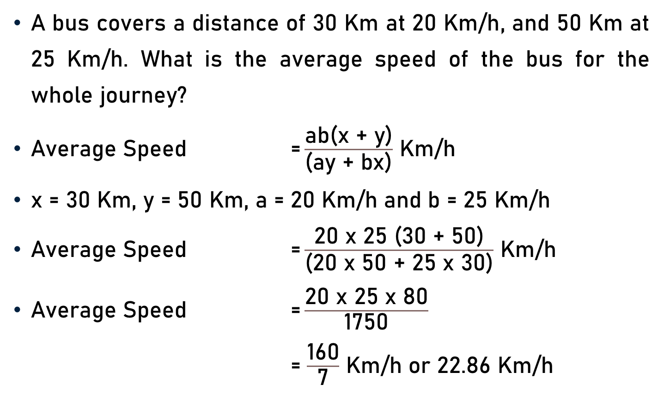
Problem 5
A bus covers a distance of 30 Km at 20 Km/h, and 50 Km at 25 Km/h. What is the average speed of the bus for the whole journey?
Average Speed $\text{=}\frac{\text{ab}\text{(}\text{x}\text{ + }\text{y}\text{)}}{\text{(}\text{ay}\text{ + }\text{bx}\text{)}}$ Km/h
x = 30 Km, y = 50 Km, a = 20 Km/h and b = 25 Km/h
Average Speed $\text{=}\frac{\text{2}\text{0 }\text{x}\text{ 25 (30 + 50)}}{\text{(}\text{20 }\text{x}\text{ 50 + 25 }\text{x}\text{ 30)}}$ Km/h
Average Speed $\text{=}\frac{\text{2}\text{0} \text{x}\text{ 25 }\text{x}\text{ 80}}{\text{17}\text{5}\text{0}}$
= $\frac{\text{160}}{\text{7}}$ Km/h or 22.86 Km/h
8
70
7

Slide 8
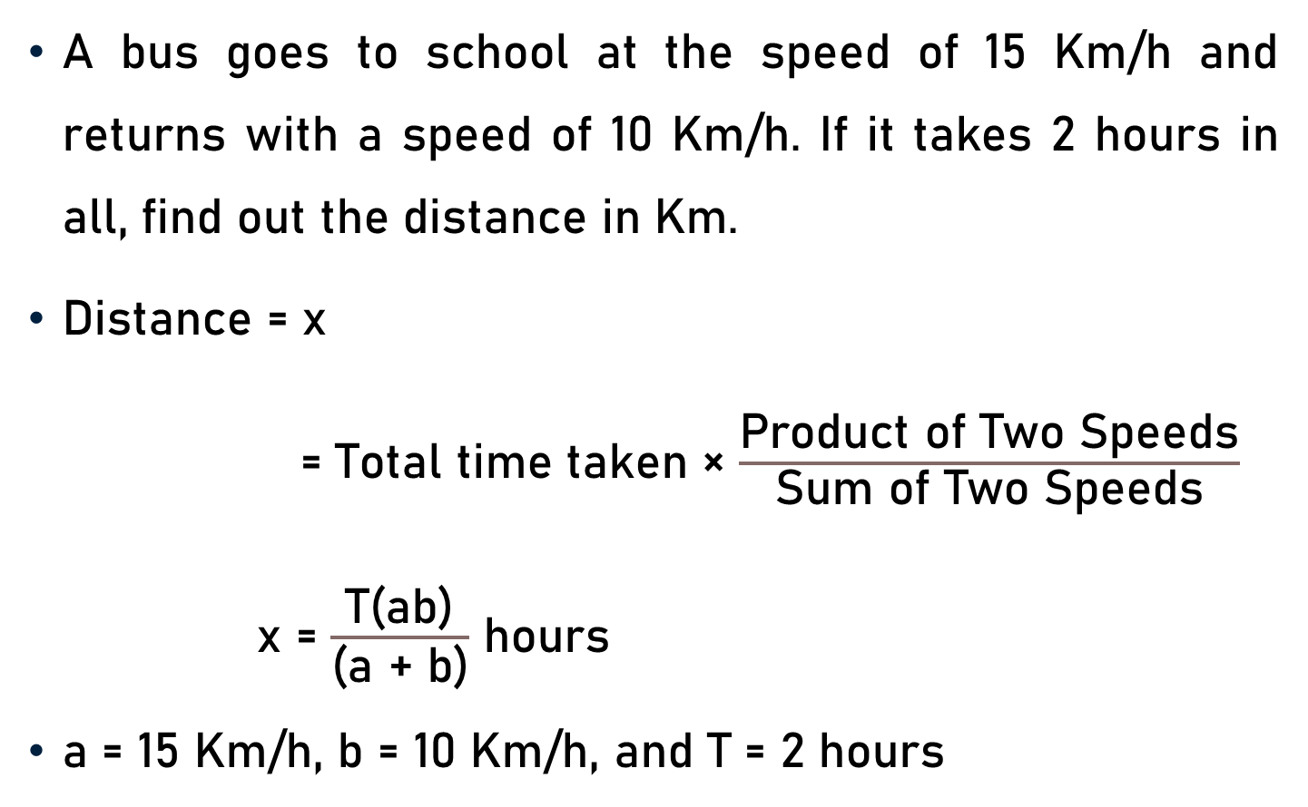
Problem 6
A bus goes to school at the speed of 15 Km/h and returns with a speed of 10 Km/h. If it takes 2 hours in all, find out the distance in Km.
Distance = x
= Total time taken × $\frac{\text{Product} \text{of} \text{Two} \text{Speeds}}{\text{Sum} \text{of} \text{Two} \text{Speeds}}$
x = $\frac{\text{T}\text{(}\text{ab}\text{)}}{\text{(}\text{a}\text{ + }\text{b}\text{)}}$ hours
a = 15 Km/h, b = 10 Km/h, and T = 2 hours

Slide 9

Problem 6
Distance, x = $\frac{\text{T}\text{(}\text{ab}\text{)}}{\text{(}\text{a}\text{ + }\text{b}\text{)}}$ hours
a = 15 Km/h, b = 10 Km/h, and T = 2 hours
x = $\frac{\text{2 }\text{x}\text{ (15 }\text{x}\text{ 10)}}{\text{(}\text{15}\text{ + }\text{10}\text{)}}$
x = $\frac{\text{2} \text{x}\text{ (150)}}{\text{(}\text{25}\text{)}}$
x = 12 Km
6

Slide 10
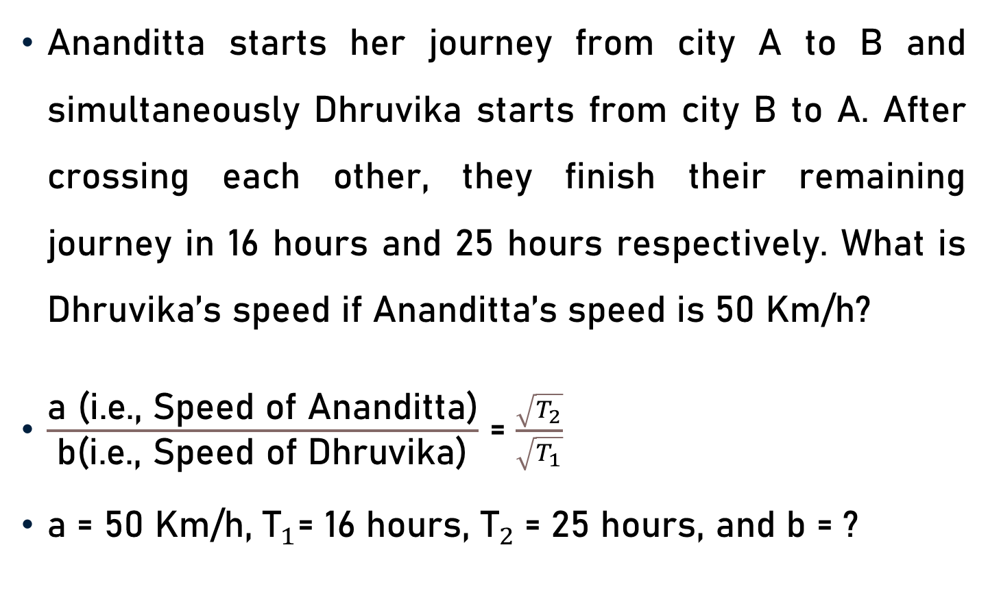
Problem 7
Ananditta starts her journey from city A to B and simultaneously Dhruvika starts from city B to A. After crossing each other, they finish their remaining journey in 16 hours and 25 hours respectively. What is Dhruvika’s speed if Ananditta’s speed is 50 Km/h?
$\frac{\text{a}\text{ (}\text{i}\text{.}\text{e}\text{., }\text{Speed} \text{of} \text{A}\text{nanditta}\text{)}}{\text{b}\text{(}\text{i}\text{.}\text{e}\text{., }\text{Speed} \text{of} \text{Dhruvika}\text{)}}$ = $\frac{\sqrt{T_{2}}}{\sqrt{T_{1}}}$
a = 50 Km/h, ${\text{T}}_{1}$= 16 hours, ${\text{T}}_{2}$= 25 hours, and b = ?

Slide 11
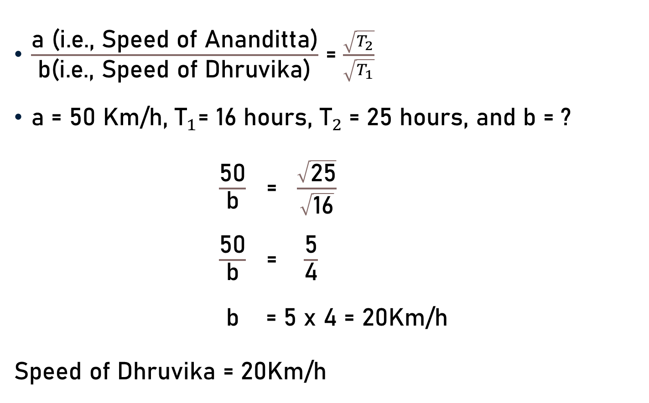
Problem 7
$\frac{\text{a}\text{ (}\text{i}\text{.}\text{e}\text{., }\text{Speed} \text{of} \text{A}\text{nanditta}\text{)}}{\text{b}\text{(}\text{i}\text{.}\text{e}\text{., }\text{Speed} \text{of} \text{Dhruvika}\text{)}}$ = $\frac{\sqrt{T_{2}}}{\sqrt{T_{1}}}$
a = 50 Km/h, ${\text{T}}_{1}$= 16 hours, ${\text{T}}_{2}$= 25 hours, and b = ?
$\frac{\text{50}}{\text{b}}$ = $\frac{\sqrt{\text{25}}}{\sqrt{\text{16}}}$
$\frac{\text{50}}{\text{b}}$ = $\frac{\text{5}}{\text{4}}$
$\text{b}$ = 5 x 4 = 20Km/h
$\text{Speed} \text{of} \text{Dhruvika}$ = 20Km/h
5

Slide 12
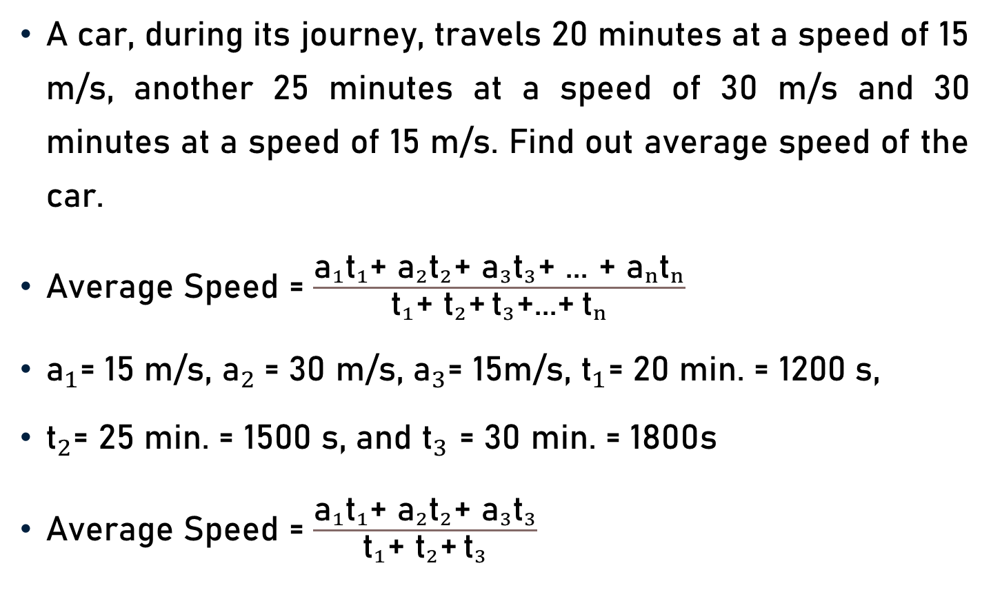
Problem 8
A car, during its journey, travels 20 minutes at a speed of 15 m/s, another 25 minutes at a speed of 30 m/s and 30 minutes at a speed of 15 m/s. Find out average speed of the car.
Average Speed = $\frac{{\text{a}}_{1}{\text{t}}_{1}\text{+ }{\text{a}}_{2}{\text{t}}_{2}\text{+ }{\text{a}}_{3}{\text{t}}_{3}\text{+ ... + }{\text{a}}_{n}{\text{t}}_{n}}{{\text{t}}_{1}\text{+ }{\text{t}}_{2}\text{+} {\text{t}}_{3}\text{+...+} {\text{t}}_{n}}$
${\text{a}}_{1}\text{= 15 }\text{m}\text{/}\text{s}\text{, }{\text{a}}_{2} \text{= 30 }\text{m}\text{/}\text{s}\text{, }{\text{a}}_{3}\text{= }\text{15}\text{m}\text{/}\text{s}$, ${\text{t}}_{1}\text{= 20 }\text{min}\text{. = 1200 }\text{s}\text{,}$
${\text{t}}_{2}\text{= 25 }\text{min}\text{. = 1500 }\text{s}\text{, }\text{and} {\text{t}}_{3}$ = 30 min. = 1800s
Average Speed = $\frac{{\text{a}}_{1}{\text{t}}_{1}\text{+ }{\text{a}}_{2}{\text{t}}_{2}\text{+ }{\text{a}}_{3}{\text{t}}_{3}}{{\text{t}}_{1}\text{+ }{\text{t}}_{2}\text{+} {\text{t}}_{3}}$

Slide 13
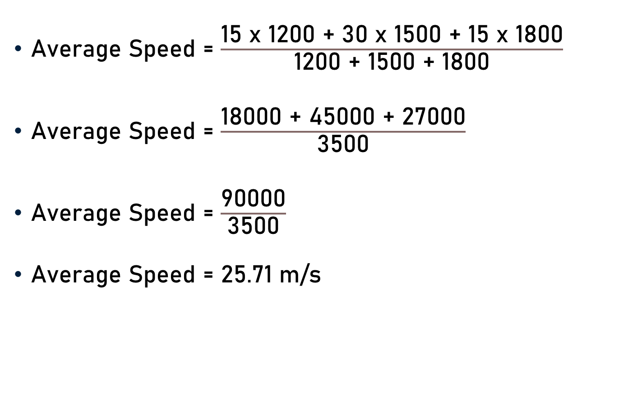
Problem 8
Average Speed = $\frac{\text{15 }\text{x}\text{ 1200 + 30 }\text{x}\text{ 1500 + 15 }\text{x}\text{ 1800}}{\text{1200 + 1500 + 1800}}$
Average Speed = $\frac{\text{1800}\text{0 + }\text{4}\text{5}\text{000}\text{ + }\text{27000}}{\text{3500}}$
Average Speed = $\frac{\text{90000}}{\text{3500}}$
Average Speed = 25.71 m/s
25.71

Slide 14
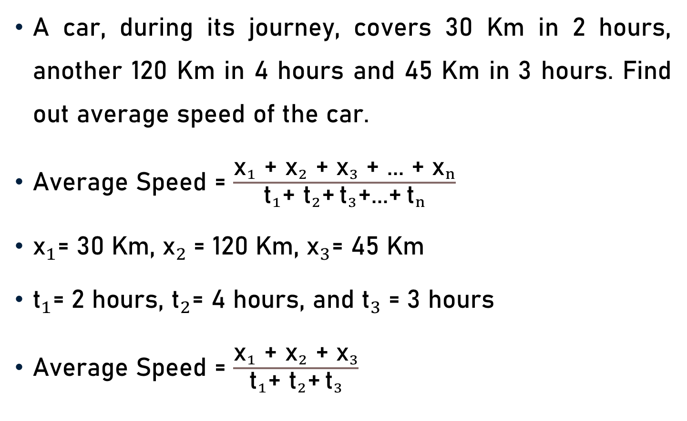
Problem 9
A car, during its journey, covers 30 Km in 2 hours, another 120 Km in 4 hours and 45 Km in 3 hours. Find out average speed of the car.
Average Speed = $\frac{{\text{x}}_{1}\text{ + }{\text{x}}_{2}\text{ + }{\text{x}}_{3}\text{ + ... + }{\text{x}}_{n}}{{\text{t}}_{1}\text{+ }{\text{t}}_{2}\text{+} {\text{t}}_{3}\text{+...+} {\text{t}}_{n}}$
${\text{x}}_{1}\text{= }\text{30 }\text{Km}\text{, }{\text{x}}_{2} \text{= }\text{120 }\text{Km}\text{, }{\text{x}}_{3}\text{= }\text{4}\text{5} \text{Km}$
${\text{t}}_{1}\text{= 2} \text{hours}\text{,}$ ${\text{t}}_{2}\text{= }\text{4 }\text{hours}\text{, }\text{and} {\text{t}}_{3}$ = 3 hours
Average Speed = $\frac{{\text{x}}_{1}\text{ + }{\text{x}}_{2}\text{ + }{\text{x}}_{3}}{{\text{t}}_{1}\text{+ }{\text{t}}_{2}\text{+} {\text{t}}_{3}}$

Slide 15
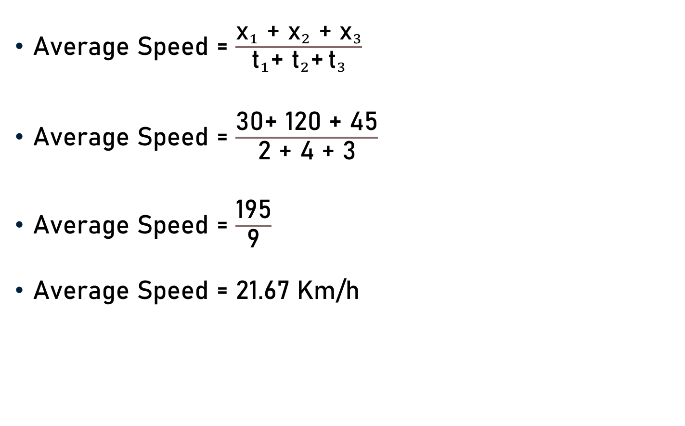
Problem 9
Average Speed = $\frac{{\text{x}}_{1}\text{ + }{\text{x}}_{2}\text{ + }{\text{x}}_{3}}{{\text{t}}_{1}\text{+ }{\text{t}}_{2}\text{+} {\text{t}}_{3}}$
Average Speed = $\frac{\text{30}\text{+ }\text{12}\text{0 + }\text{4}\text{5}}{\text{2 + }\text{4}\text{ + }\text{3}}$
Average Speed = $\frac{\text{195}}{\text{9}}$
Average Speed = 21.67 Km/h
21.67

Slide 16
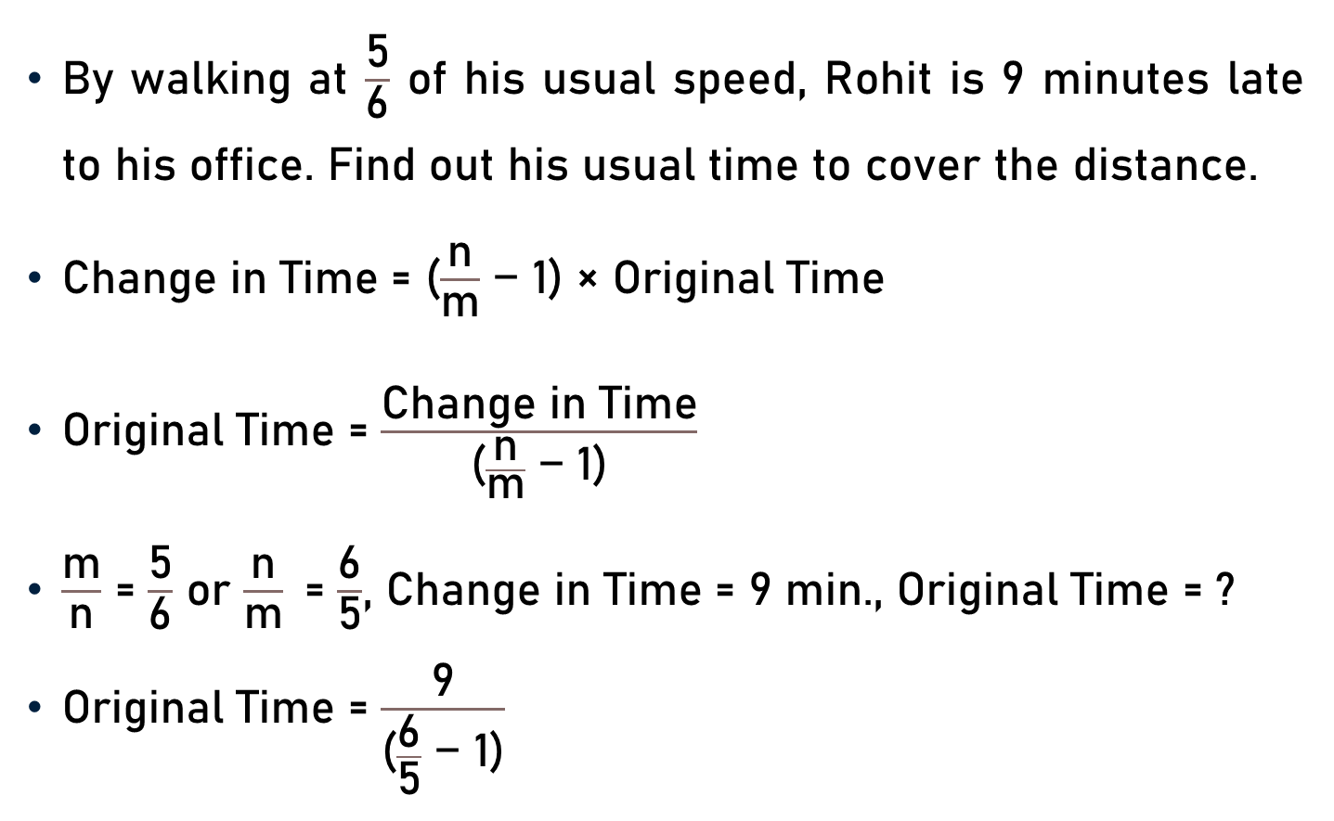
Problem 10
By walking at $\frac{\text{5}}{\text{6}}$ of his usual speed, Rohit is 9 minutes late to his office. Find out his usual time to cover the distance.
Change in Time = ($\frac{\text{n}}{\text{m}}$ − 1) × Original Time
Original Time = $\frac{\text{Change} \text{in} \text{Time}}{\text{(}\frac{\text{n}}{\text{m}}\text{ − 1)}}$
$\frac{\text{m}}{\text{n}}$ = $\frac{\text{5}}{\text{6}}$ or $\frac{\text{n}}{\text{m}}$= $\frac{\text{6}}{\text{5}}$, Change in Time = 9 min., Original Time = ?
Original Time = $\frac{\text{9}}{\text{(}\frac{\text{6}}{\text{5}}\text{ − 1)}}$

Slide 17

Problem 10
Original Time = $\frac{\text{9}}{\text{(}\frac{\text{6}}{\text{5}}\text{ − 1)}}$
Original Time = $\frac{\text{9}}{\text{(}\frac{\text{6− }\text{5}}{\text{5}}\text{)}}$
Original Time = $\frac{\text{9} \text{x}\text{ 5}}{\text{1}}$
Original Time =$\text{45 }$minutes

Slide 18
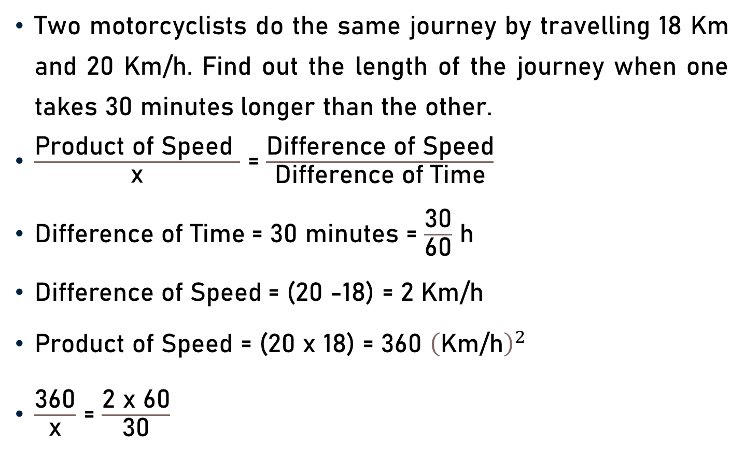
Problem 11
Two motorcyclists do the same journey by travelling 18 Km and 20 Km/h. Find out the length of the journey when one takes 30 minutes longer than the other.
$\frac{\text{Product} \text{of} \text{S}\text{peed} }{\text{x}}$ = $\frac{\text{Difference} \text{of} \text{Speed}}{\text{Difference} \text{of} \text{Time}}$
$\text{Difference} \text{of} \text{Time}$= 30 minutes = $\frac{\text{30}}{\text{60}}$ h
$\text{Difference} \text{of} \text{Speed}$= (20 -18) = 2 Km/h
$\text{Product} \text{of} \text{S}\text{peed}$= (20 x 18) = 360 ${\left(\text{Km}\text{/}\text{h}\right)}^{2}$
$\frac{\text{360}}{\text{x}}$ = $\frac{\text{2 }\text{x}\text{ 60}}{\text{30}}$

Slide 19

Problem 11
$\frac{\text{360}}{\text{x}}$ = $\frac{\text{2 }\text{x}\text{ 60}}{\text{30}}$
$\frac{\text{360}}{\text{x}}$ = $\frac{\text{2 }\text{x}\text{ 60}}{\text{30}}$
$\text{x}$ = $\frac{\text{360} \text{x}\text{ 30}}{\text{2 }\text{x}\text{ 60}}$
x = 90 Km
6
15

Slide 20
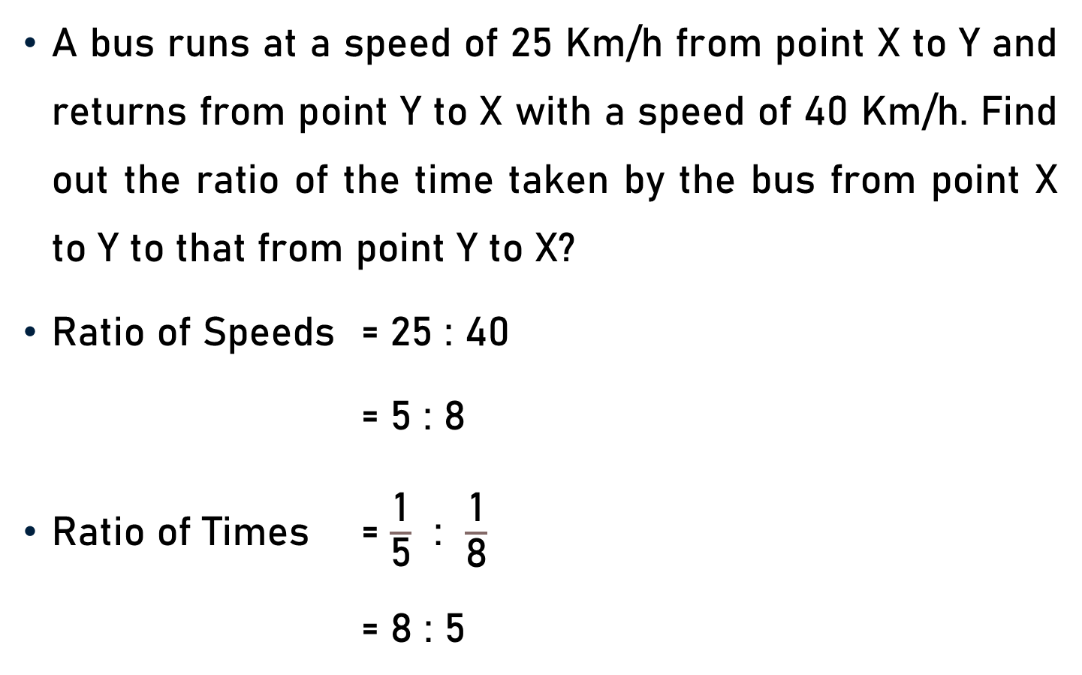
Problem 12
A bus runs at a speed of 25 Km/h from point X to Y and returns from point Y to X with a speed of 40 Km/h. Find out the ratio of the time taken by the bus from point X to Y to that from point Y to X?
Ratio of Speeds = 25 : 40
= 5 : 8
Ratio of Times = $\frac{\text{1}}{\text{5}}$ : $\frac{\text{1}}{\text{8}}$
= 8 : 5
5
8

Slide 21

Conclusion
Speed = $\frac{\text{Distance} \text{Travelled}}{\text{Time} \text{Taken}}$
Speed x $\text{Time}$=$\text{Distance}$
$\text{Time}$= $\frac{\text{Distance}}{\text{Speed}}$
$\text{1}$ Km/h = $\frac{\text{5} }{\text{18 }}\text{m}\text{/}\text{s}$ & $\text{1}$ $\text{m}\text{/}\text{s}$ = $\frac{\text{18} }{\text{5 }}$ Km/h
Average Speed = $\frac{\text{Total} \text{Distance} \text{Covered} }{\text{Total} \text{Time} \text{Taken} }$

Slide 22
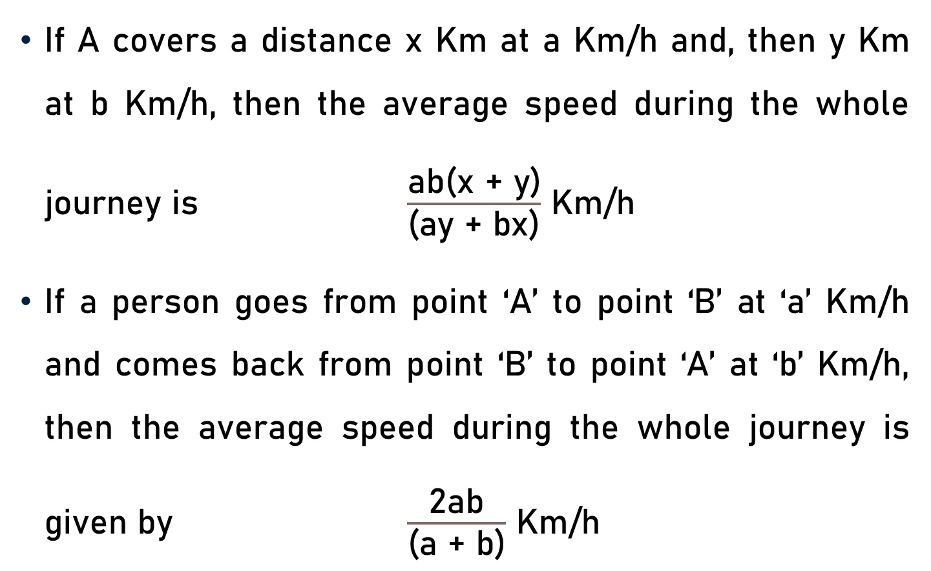
Conclusion
If A covers a distance x Km at a Km/h and, then y Km at b Km/h, then the average speed during the whole journey is $\frac{\text{ab}\text{(}\text{x}\text{ + }\text{y}\text{)}}{\text{(}\text{ay}\text{ + }\text{bx}\text{)}}$ Km/h
If a person goes from point ‘A’ to point ‘B’ at ‘a’ Km/h and comes back from point ‘B’ to point ‘A’ at ‘b’ Km/h, then the average speed during the whole journey is given by $\frac{\text{2}\text{ab}}{\text{(}\text{a}\text{ + }\text{b}\text{)}}$ Km/h

Slide 23
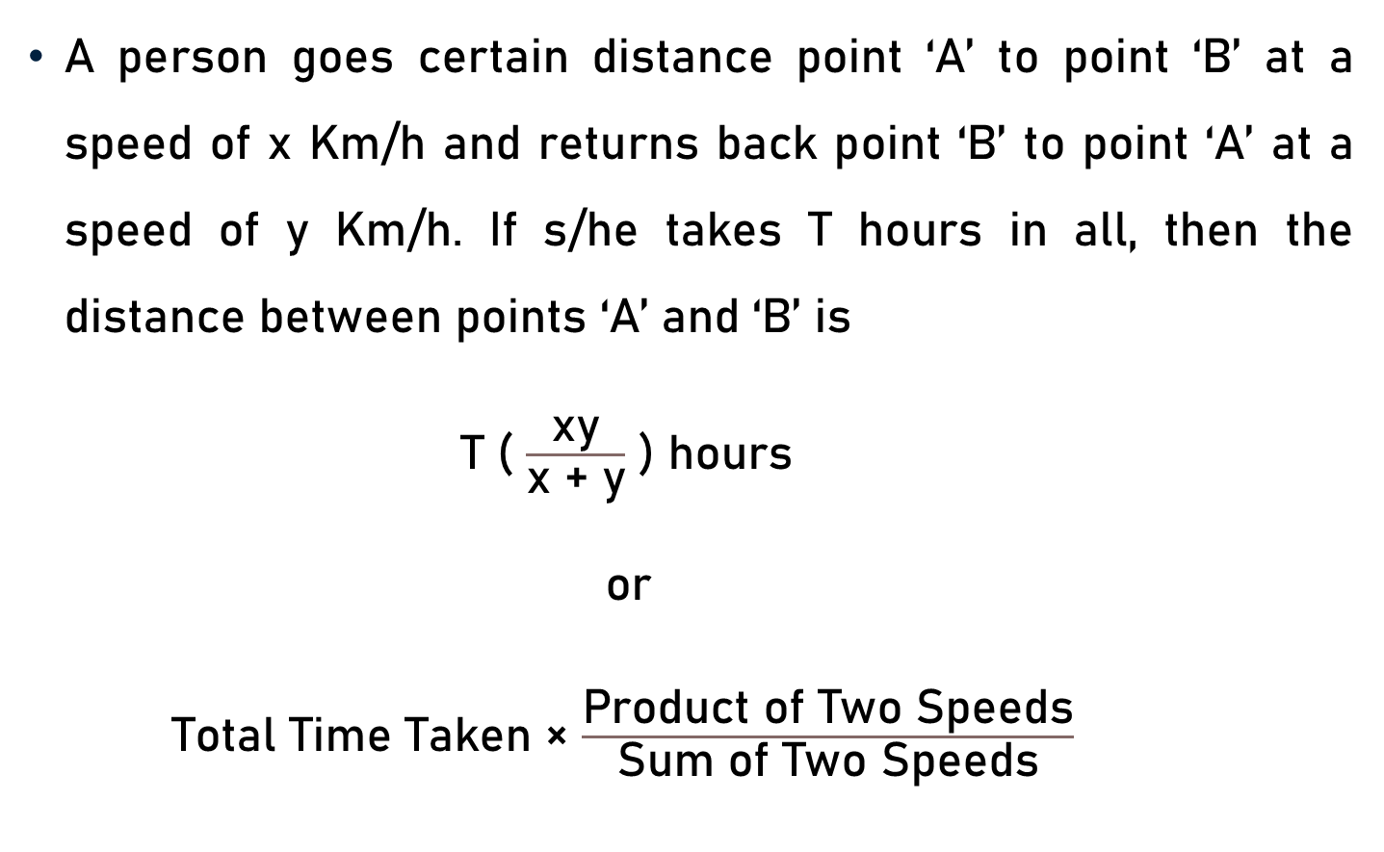
Conclusion
A person goes certain distance point ‘A’ to point ‘B’ at a speed of x Km/h and returns back point ‘B’ to point ‘A’ at a speed of y Km/h. If s/he takes T hours in all, then the distance between points ‘A’ and ‘B’ is
T ( $\frac{\text{xy}}{\text{x}\text{ + }\text{y}}$ ) hours
or
Total Time Taken × $\frac{\text{Product} \text{of} \text{T}\text{wo} \text{S}\text{peeds}}{\text{Sum} \text{of} \text{T}\text{wo} \text{S}\text{peeds}}$

Slide 24
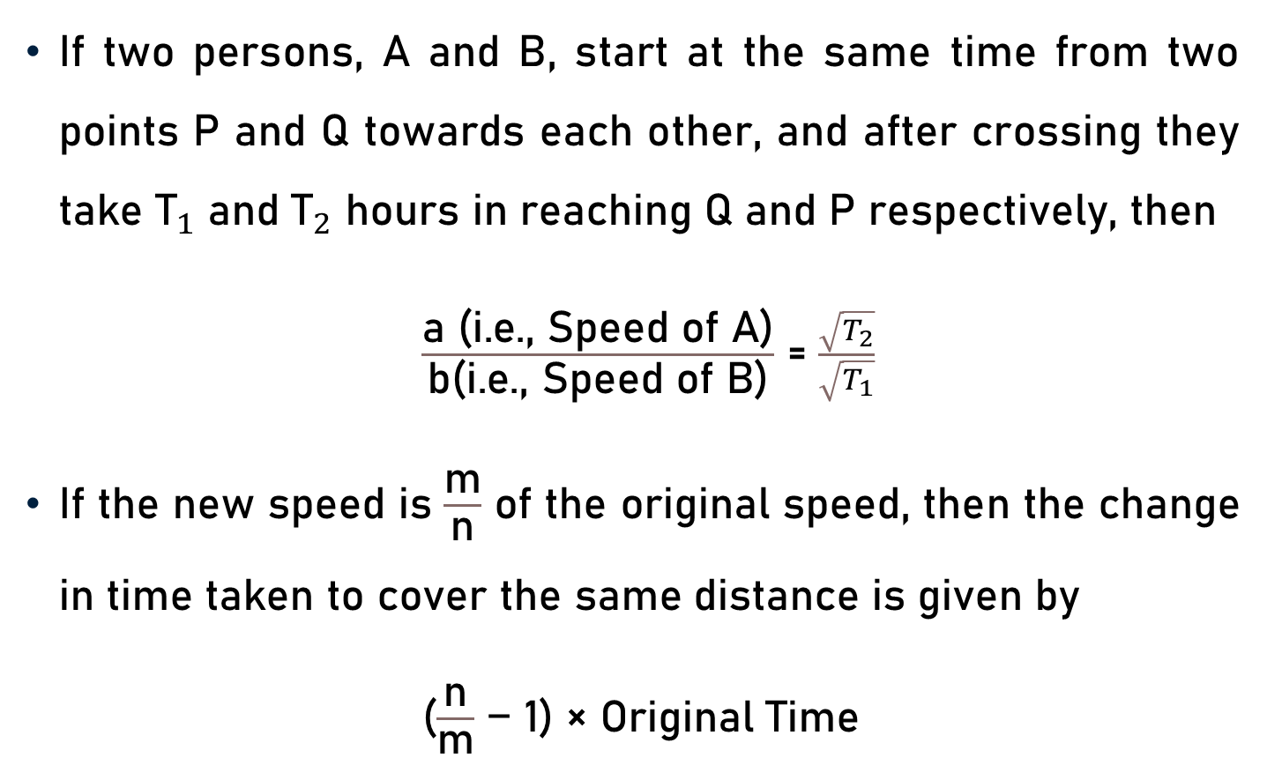
Conclusion
If two persons, A and B, start at the same time from two points P and Q towards each other, and after crossing they take ${\text{T}}_{1}$ and ${\text{T}}_{2}$ hours in reaching Q and P respectively, then
$\frac{\text{a}\text{ (}\text{i}\text{.}\text{e}\text{., }\text{Speed} \text{of} \text{A}\text{)}}{\text{b}\text{(}\text{i}\text{.}\text{e}\text{., }\text{Speed} \text{of} \text{B}\text{)}}$ = $\frac{\sqrt{T_{2}}}{\sqrt{T_{1}}}$
If the new speed is $\frac{\text{m}}{\text{n}}$ of the original speed, then the change in time taken to cover the same distance is given by
($\frac{\text{n}}{\text{m}}$ − 1) × Original Time

Slide 25
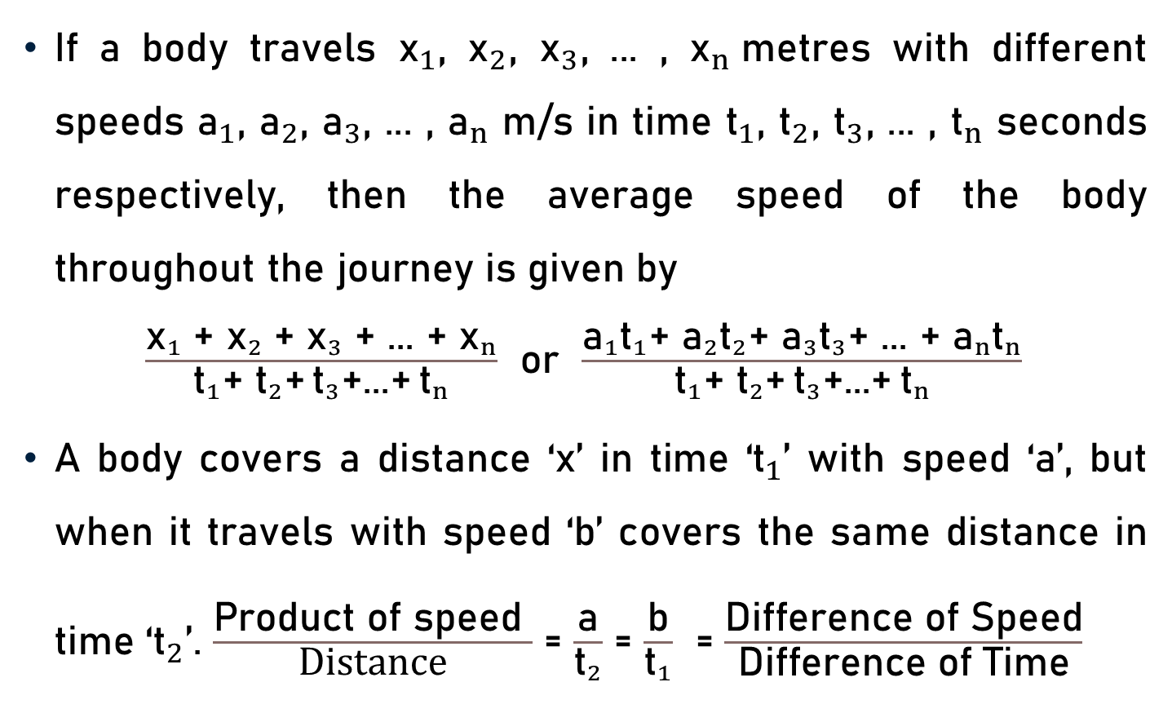
Conclusion
If a body travels ${\text{x}}_{1}$, ${\text{x}}_{2}$, ${\text{x}}_{3}$, ... , ${\text{x}}_{n}$metres with different speeds ${\text{a}}_{1}$, ${\text{a}}_{2}$, ${\text{a}}_{3}$, ... , ${\text{a}}_{n}$ m/s in time ${\text{t}}_{1}$, ${\text{t}}_{2}$, ${\text{t}}_{3}$, ... , ${\text{t}}_{n}$ seconds respectively, then the average speed of the body throughout the journey is given by
$\frac{{\text{x}}_{1}\text{ +} {\text{x}}_{2}\text{ +} {\text{x}}_{3}\text{ +}\text{ ... }\text{+} {\text{x}}_{n}}{{\text{t}}_{1}\text{+} {\text{t}}_{2}\text{+} {\text{t}}_{3}\text{+...+} {\text{t}}_{n}}$ or $\frac{{\text{a}}_{1}{\text{t}}_{1}\text{+ }{\text{a}}_{2}{\text{t}}_{2}\text{+ }{\text{a}}_{3}{\text{t}}_{3}\text{+ ... + }{\text{a}}_{n}{\text{t}}_{n}}{{\text{t}}_{1}\text{+ }{\text{t}}_{2}\text{+} {\text{t}}_{3}\text{+...+} {\text{t}}_{n}}$
A body covers a distance ‘x’ in time ‘${\text{t}}_{1}$’ with speed ‘a’, but when it travels with speed ‘b’ covers the same distance in time ‘${\text{t}}_{2}$’. $\frac{\text{Product} \text{of} \text{speed} }{\text{Distance}}$ = $\frac{\text{a}}{{\text{t}}_{2}}$ = $\frac{\text{b}}{{\text{t}}_{1}}$ = $\frac{\text{Difference} \text{of} \text{S}\text{peed}}{\text{Difference} \text{of} \text{Time}}$

Slide 26
Summary
Problems
  Speed
  Distance
  Time
  Average Speed

